Slide 1
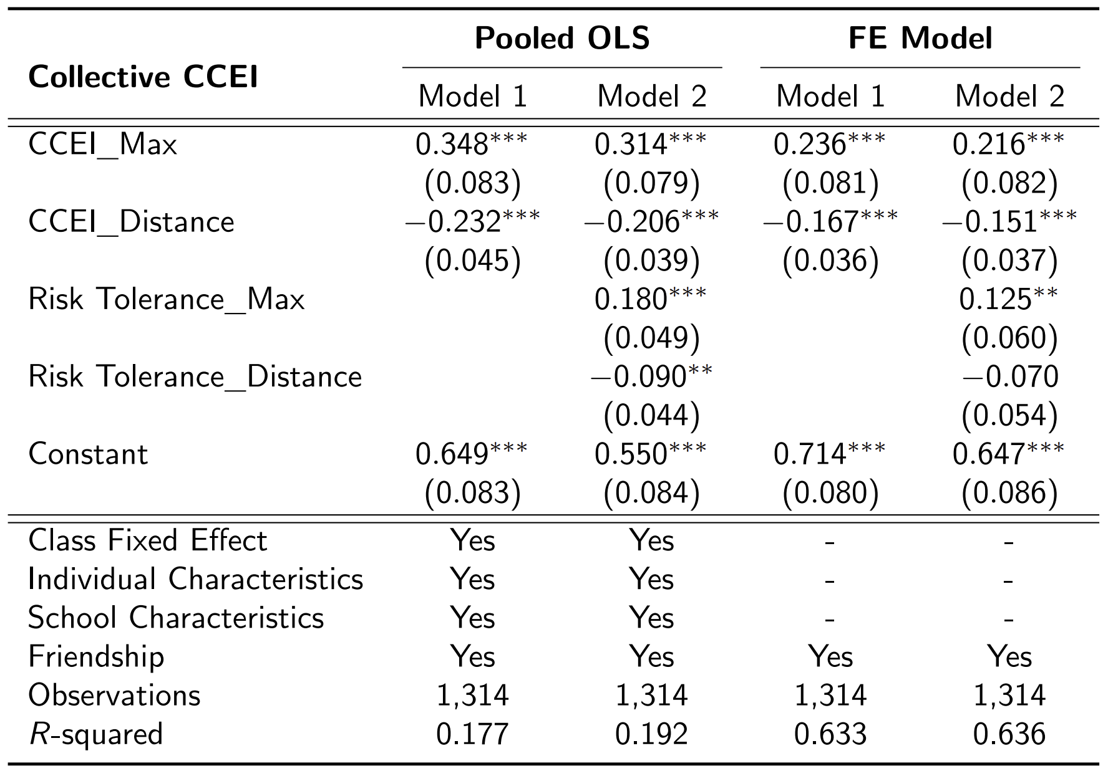
Rationality Extension
Collective CCEI increases in CCEI of a more rational individual and decreases in the difference between CCEIs of two individuals, even after controlling for preferences.

Slide 2
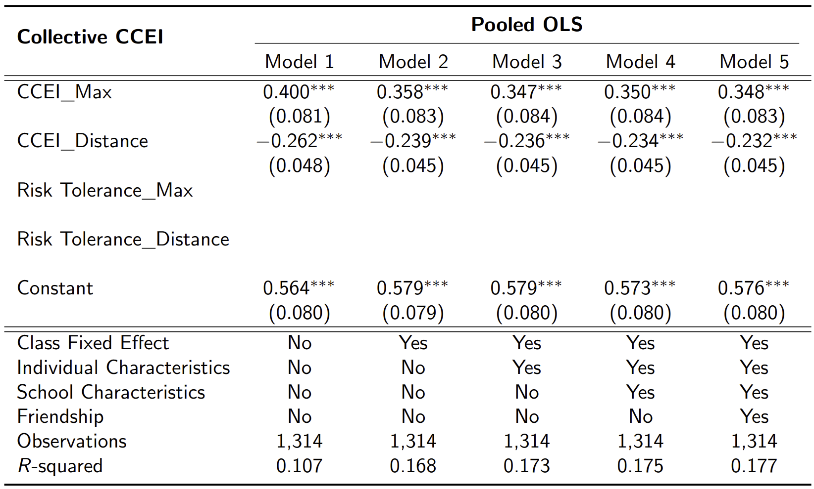
(수정) Rationality Extension

Slide 3
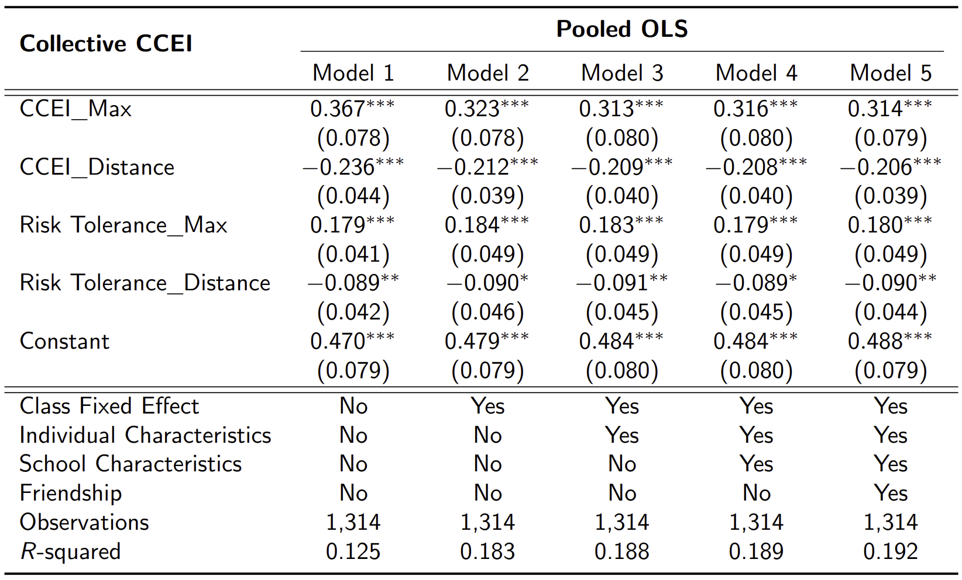
(수정) Rationality Extension

Slide 4
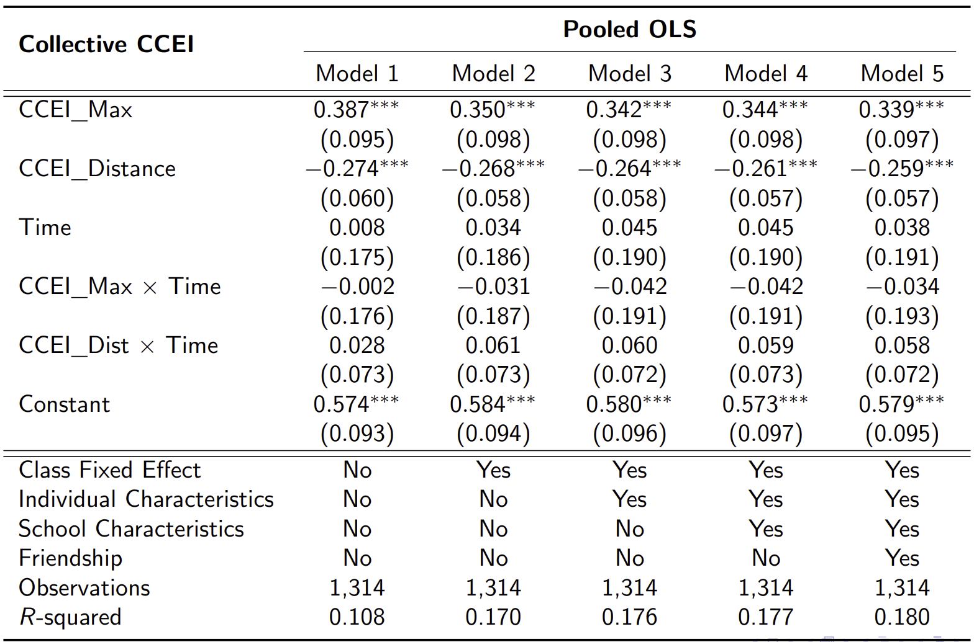
(수정) Rationality Extension

Slide 5
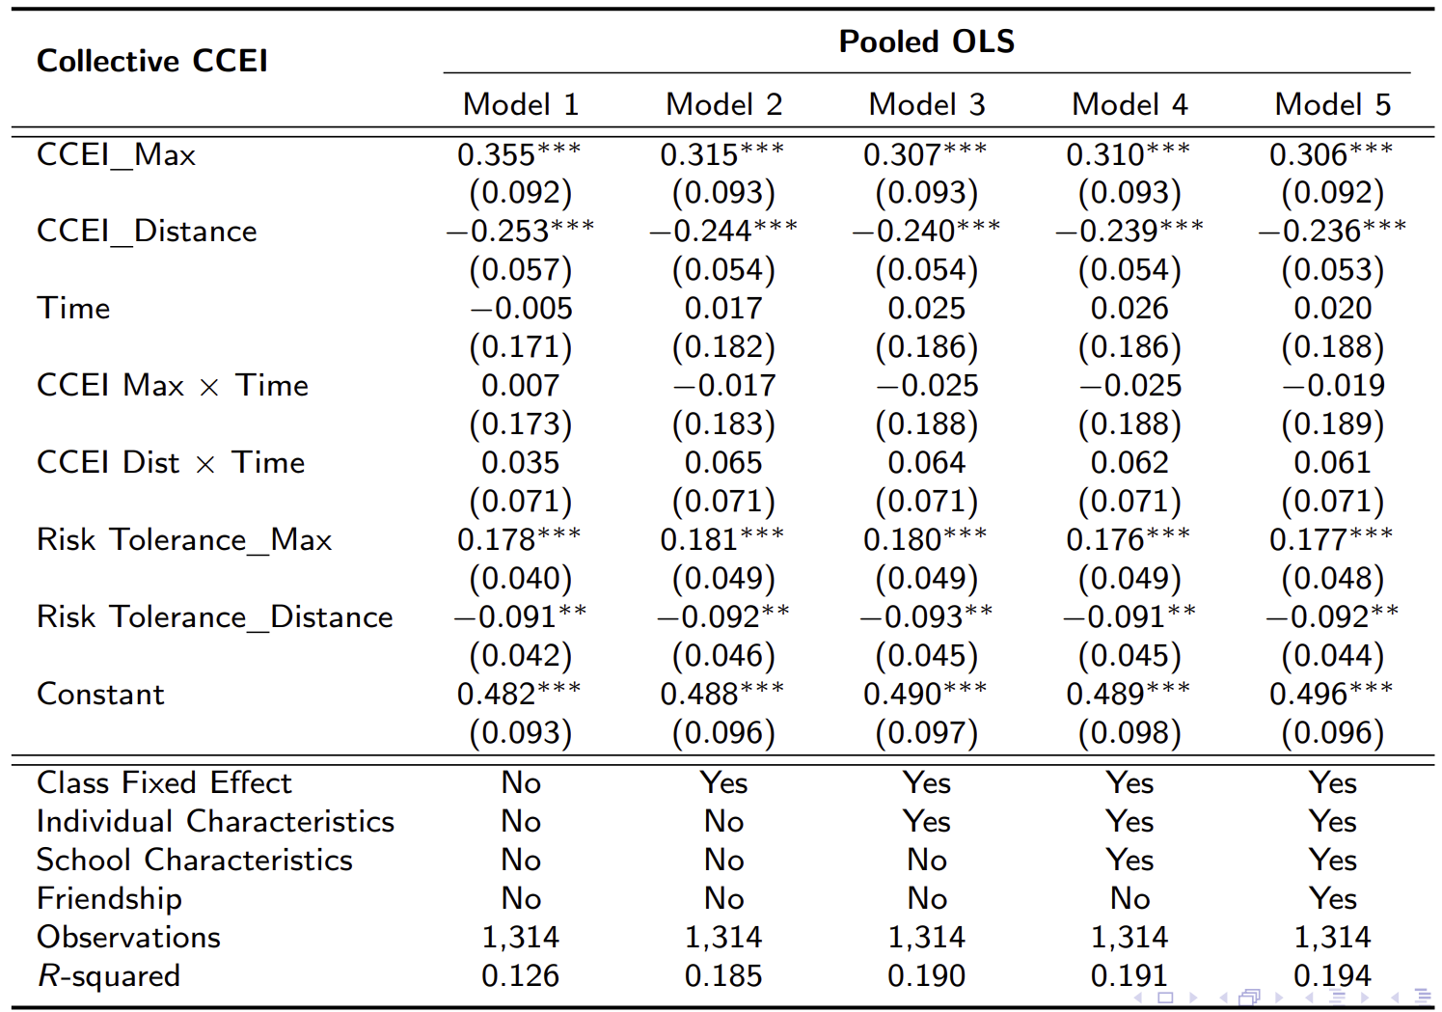
(수정) Rationality Extension

Slide 6
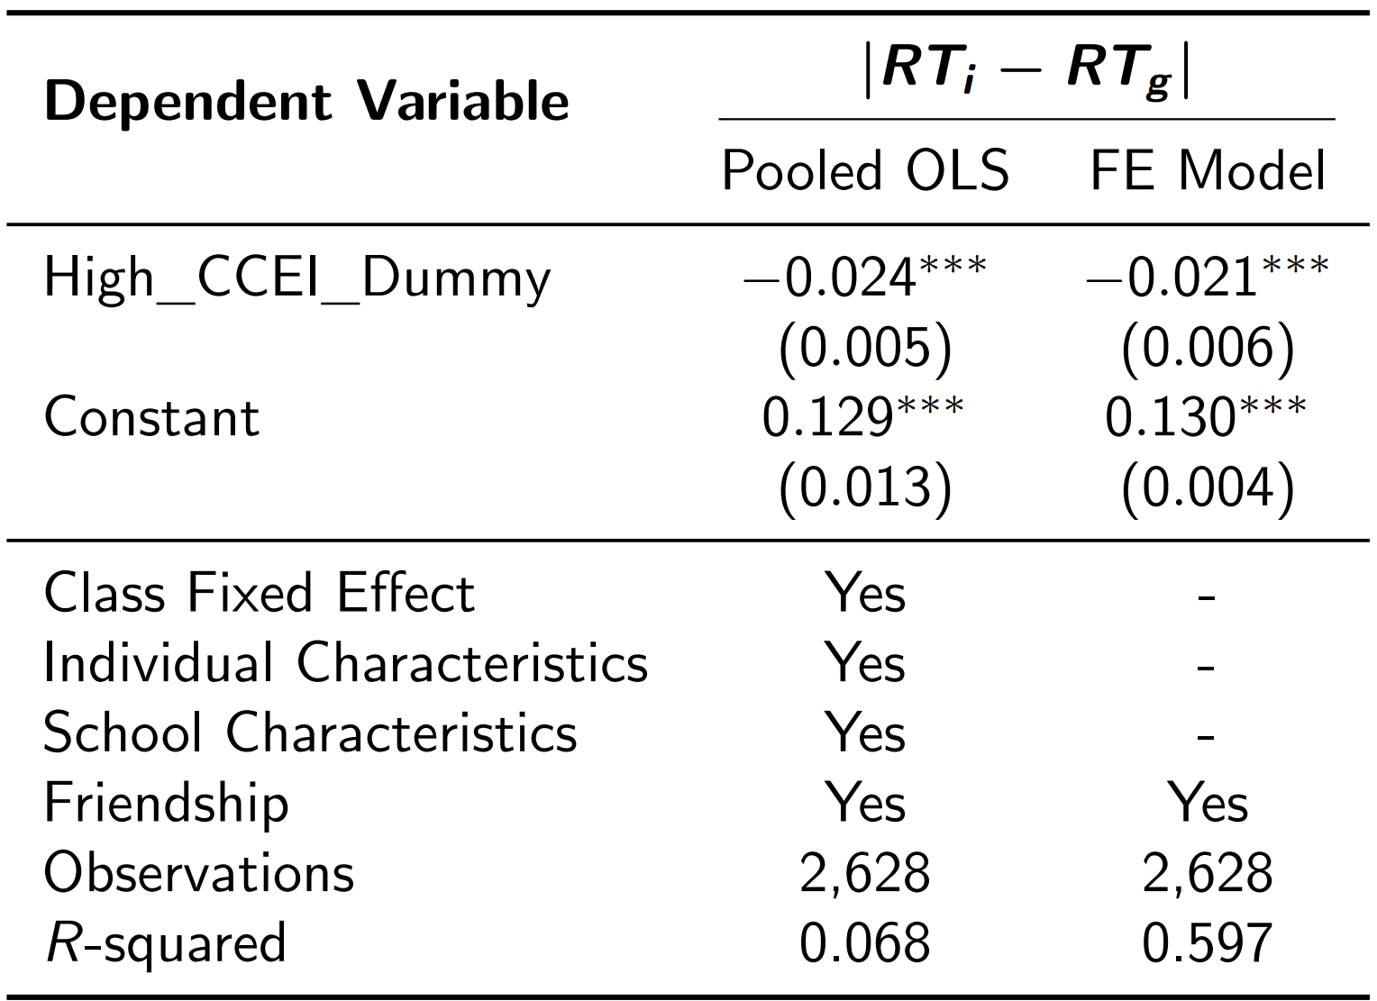
Risk Aversion
Collective risk preference is closer to the individual risk preference of a more rational individual.

Slide 7
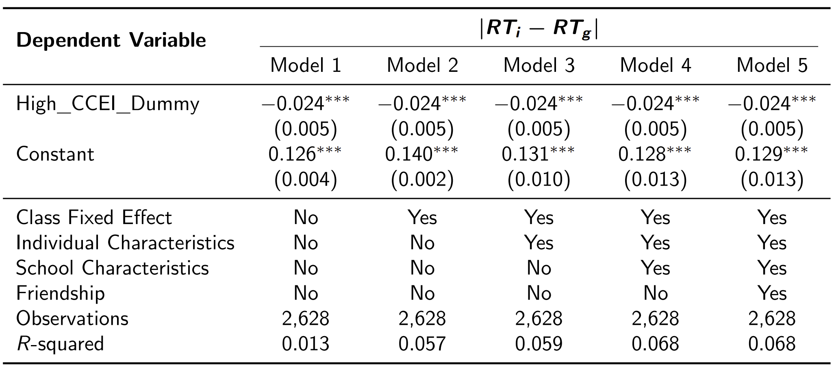
(수정) Rationality Extension

Slide 8
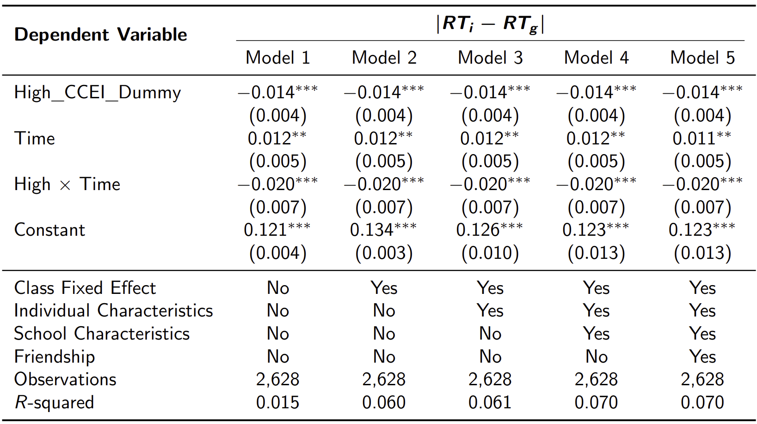
(수정) Risk Aversion

Slide 9
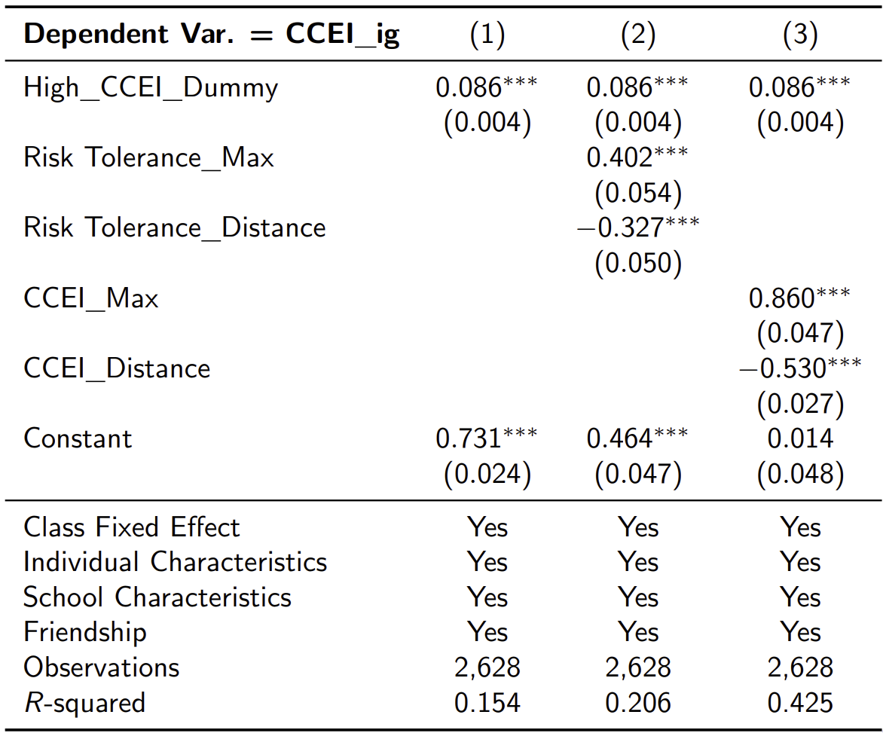
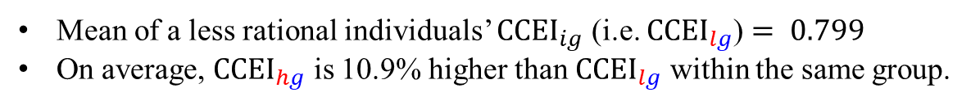
Revealed Influence of More Rational Individuals
Mean of a less rational individuals’ ${CCEI}_{ig}$ (i.e. ${CCEI}_{lg}$) $= 0.799$
On average, ${CCEI}_{hg}$ is 10.9% higher than ${CCEI}_{lg}$ within the same group.

Slide 10
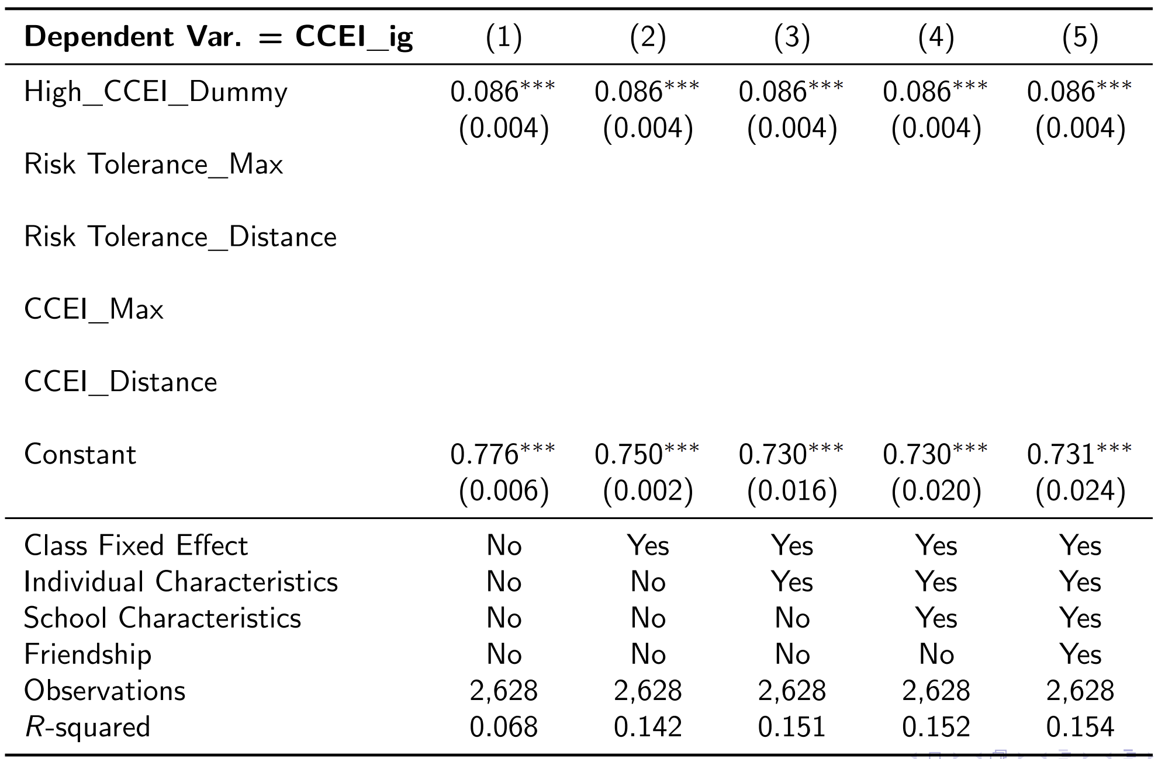
(수정)Revealed Influence of More Rational Individuals

Slide 11
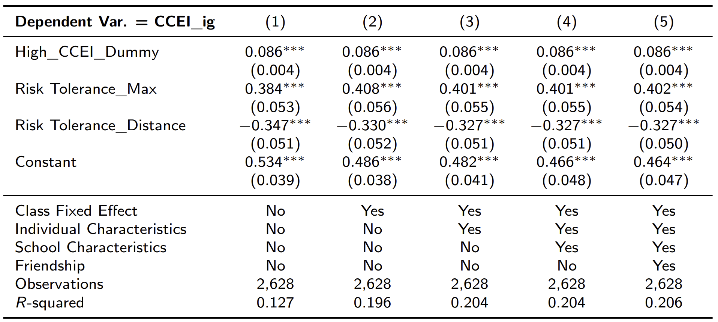
(수정)Revealed Influence of More Rational Individuals

Slide 12
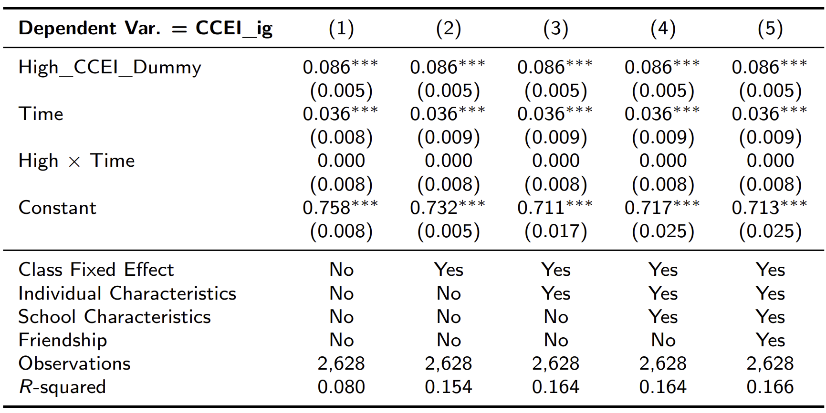
(수정)Revealed Influence of More Rational Individuals

Slide 13
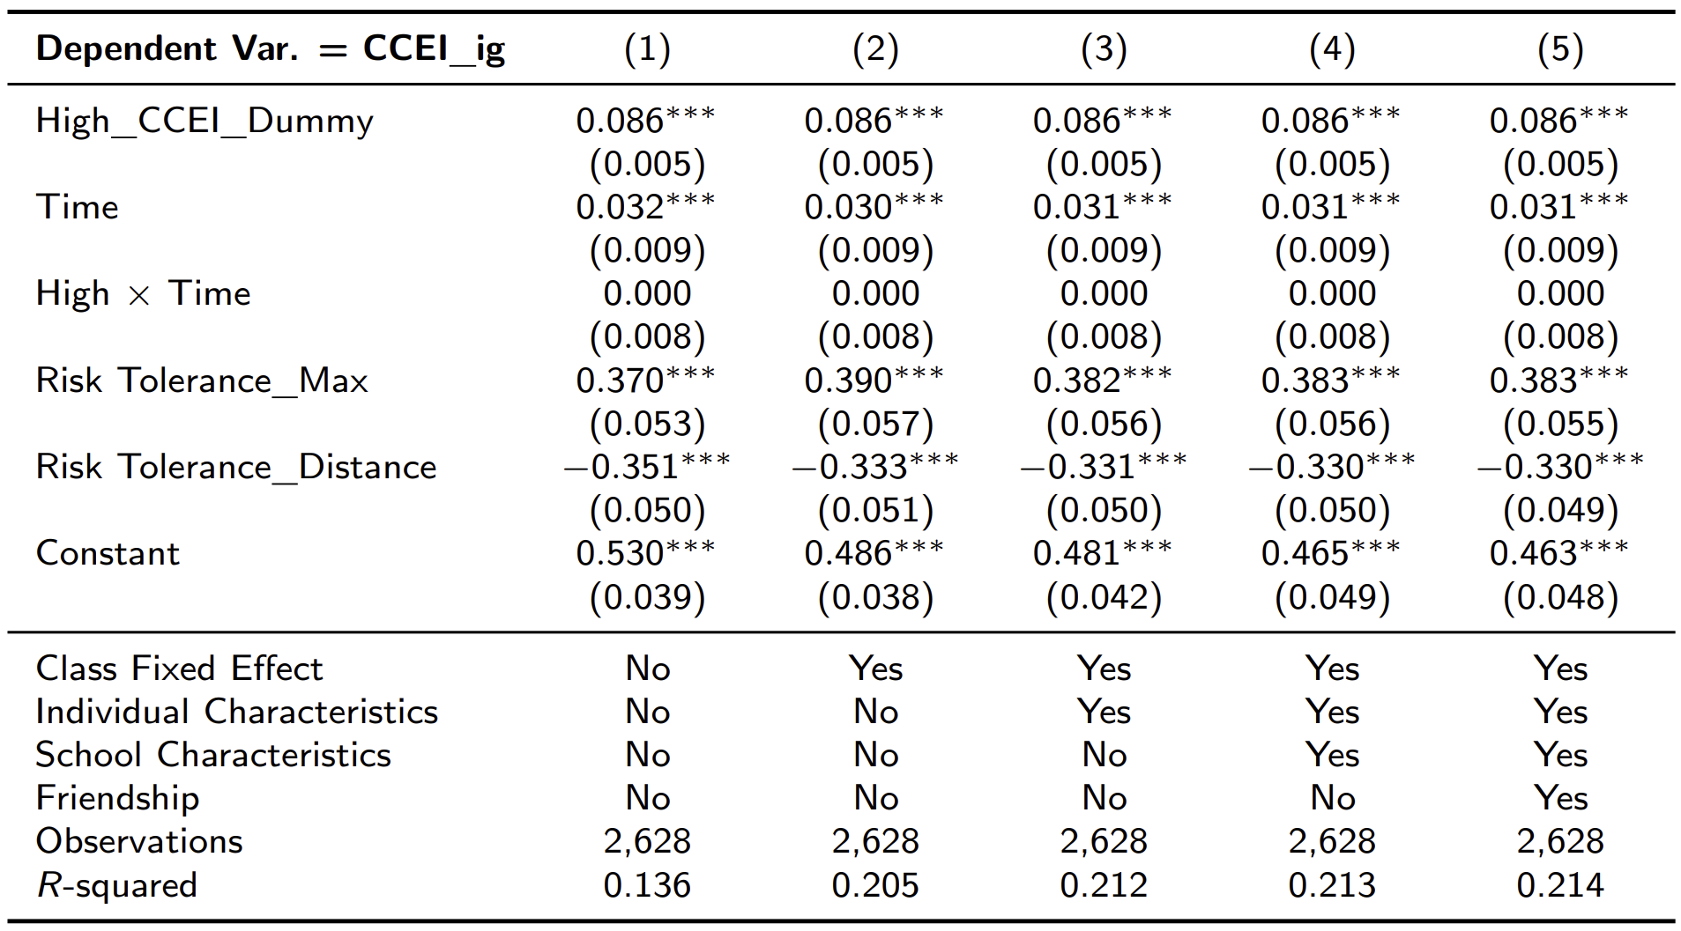
(수정)Revealed Influence of More Rational Individuals

Slide 14
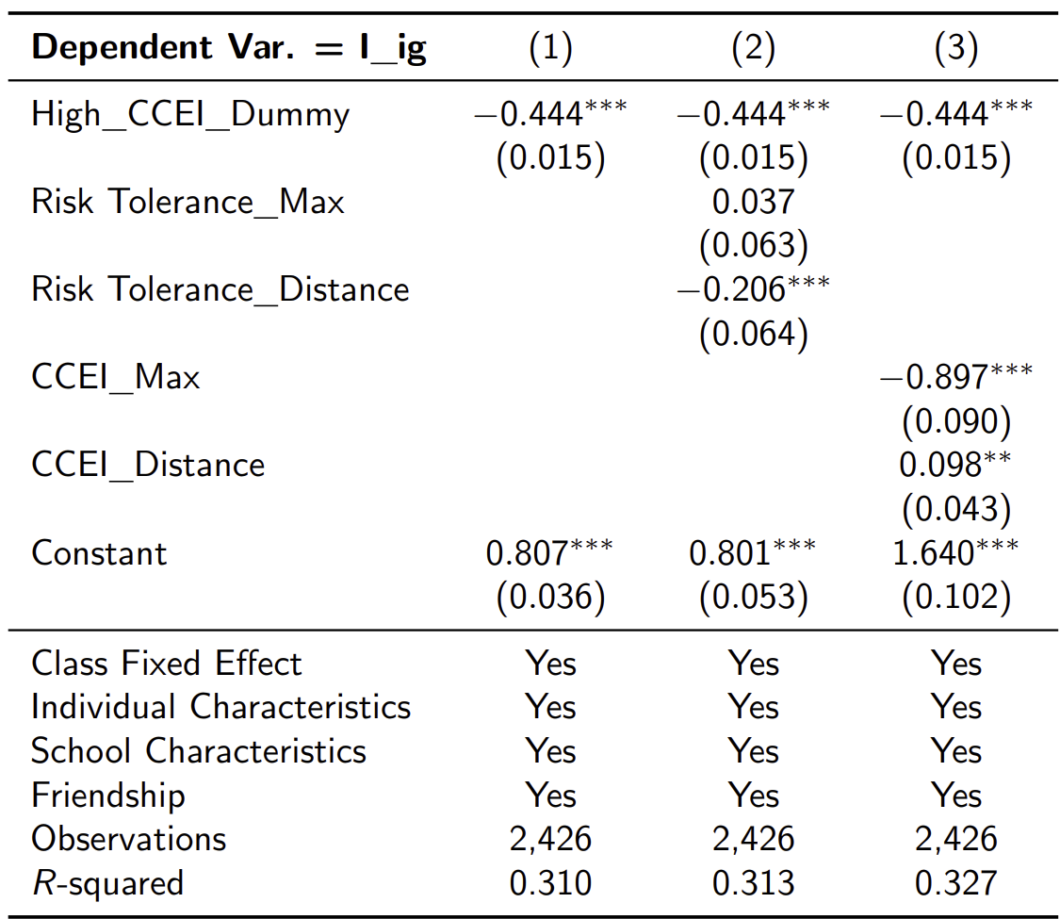
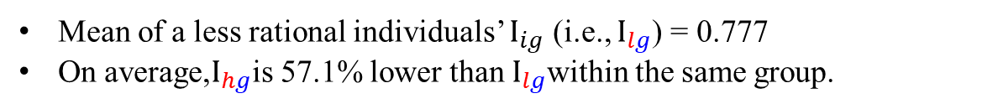
Revealed Influence of More Rational Individuals
Mean of a less rational individuals’ $I_{ig}$ (i.e., $I_{lg}$) = 0.777
On average,$I_{hg}$is 57.1% lower than $I_{lg}$within the same group.

Slide 15
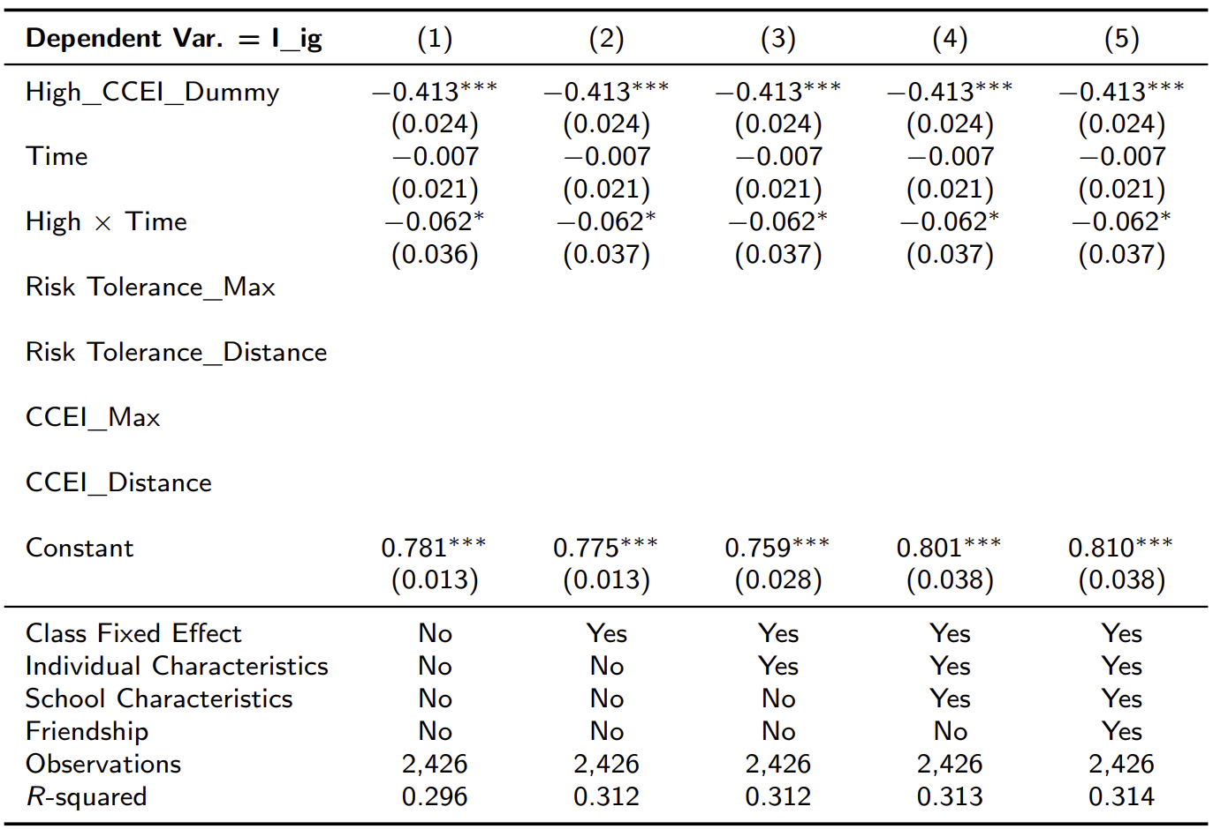
(수정) Revealed Influence of More Rational Individuals

Slide 16
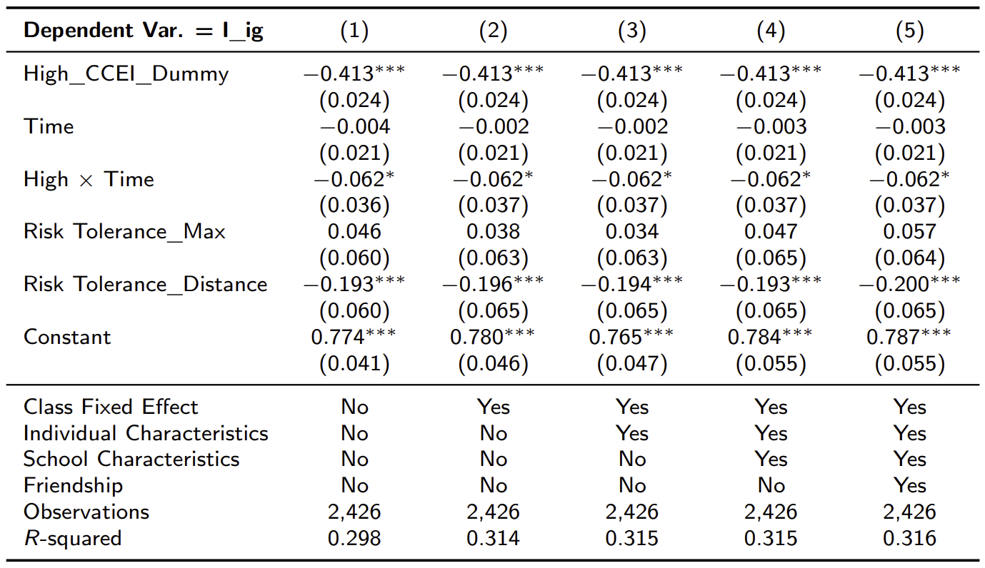
(수정) Revealed Influence of More Rational Individuals

Slide 17
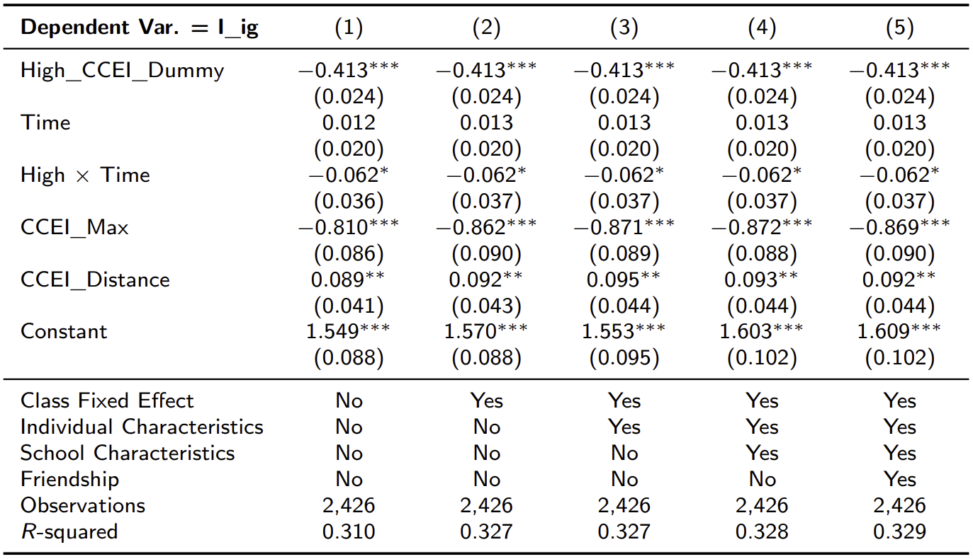
(수정) Revealed Influence of More Rational Individuals

